Slide 1


ORGAN ON A CHIP
BY
NUBAISH AHAMED.S
snahmed2019

Slide 2








OVERVIEW
Introduction
Applications
OOAC
Features
Working
Future Goals
Lung on a Chip

Slide 3

INTRODUCTION
Drug development is notoriously slow and expensive.
Cost more than $3 billion to bring a new compound from the lab bench to market.
Drugs that appear to be safe and effective in animals frequently turn out to be harmful or ineffective in humans.
This mismatch in biology causes many useless or toxic drugs to advance through clinical trials at great expense, while potentially effective compounds never make it to market.

Slide 4
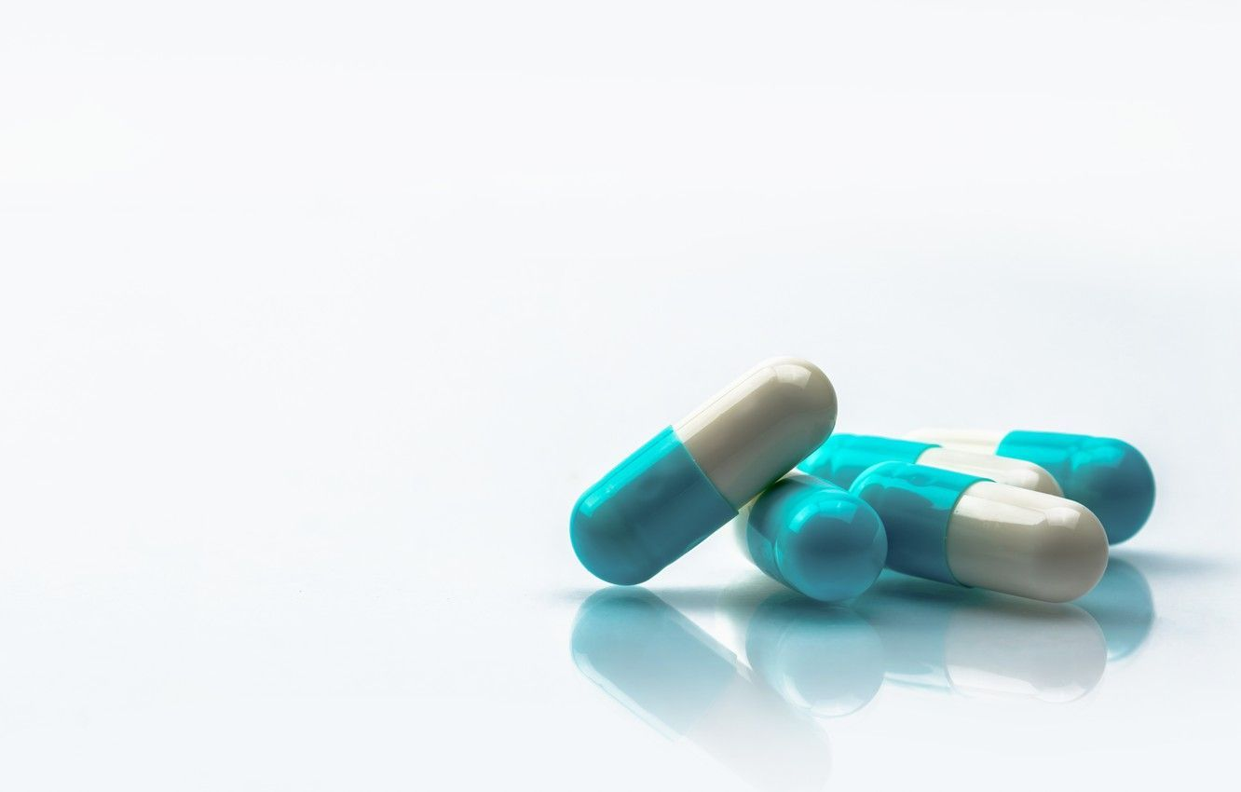
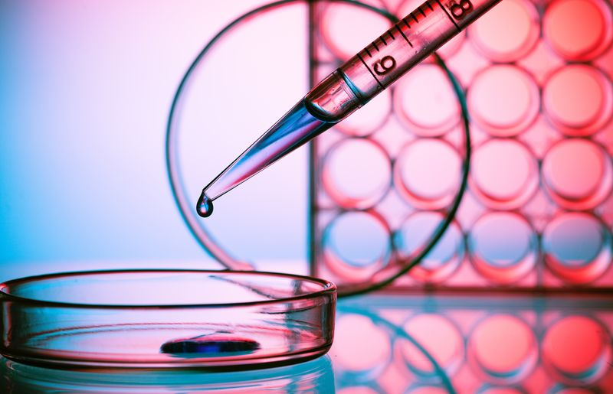
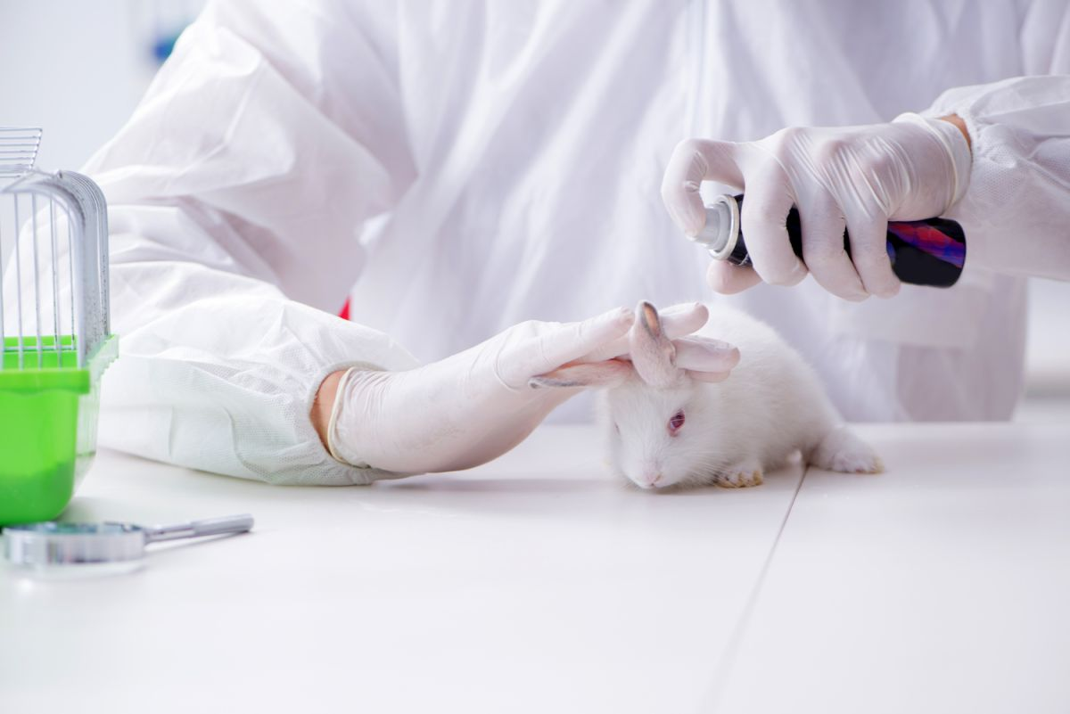
TESTING METHODS
Animal Testing
IN-VITRO Testing

Slide 5


Slide 6
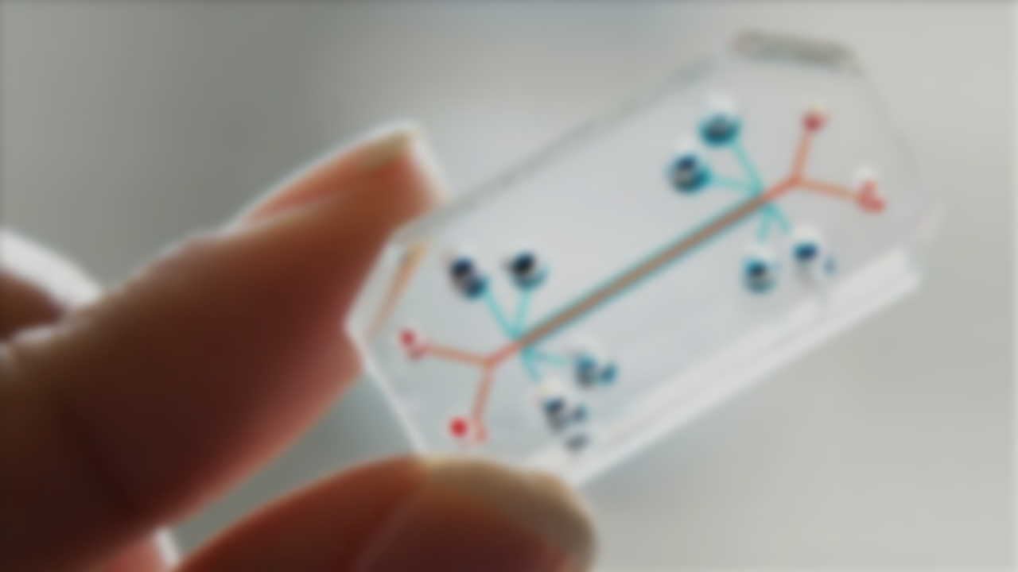
What is OOAC ?
An organ-on-a-chip is a micro-scale system used for mimicking the human body environment. The goal for organ-on-a-chip is to develop human tissue models for disease modeling and drug testing. They use microfluidics, along with cells, to imitate the physiological and mechanical conditions experienced in the body.

Slide 7
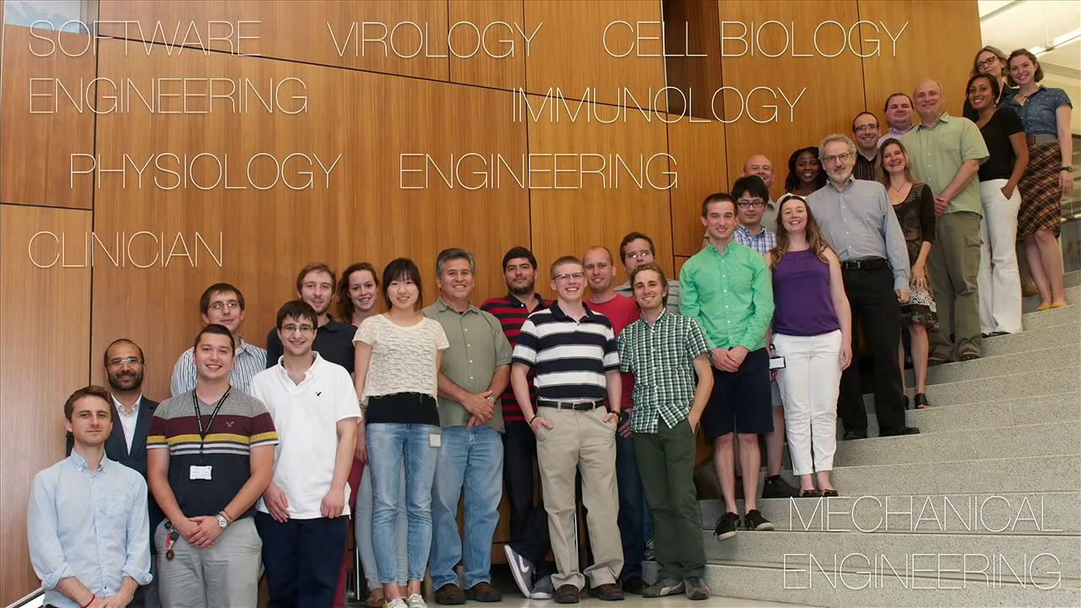

Slide 8
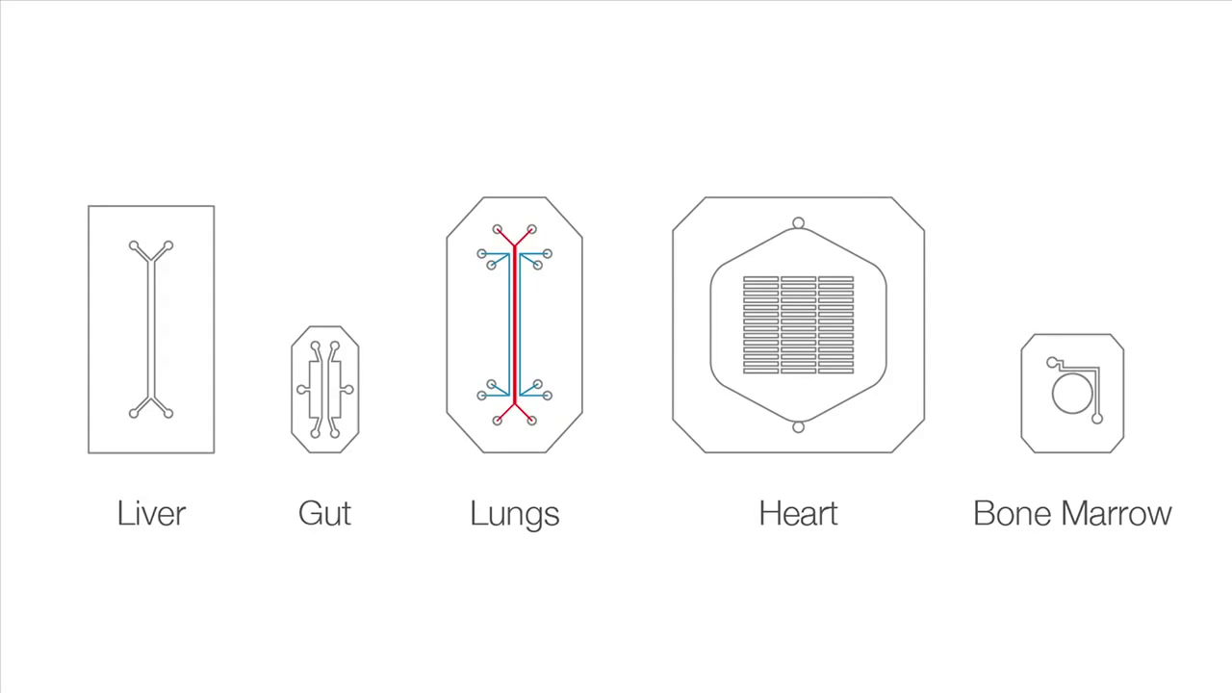

Slide 9
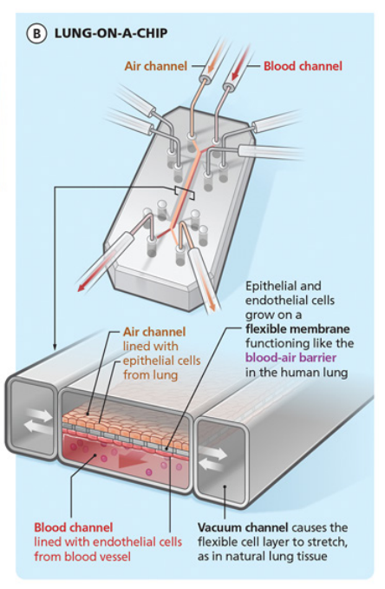
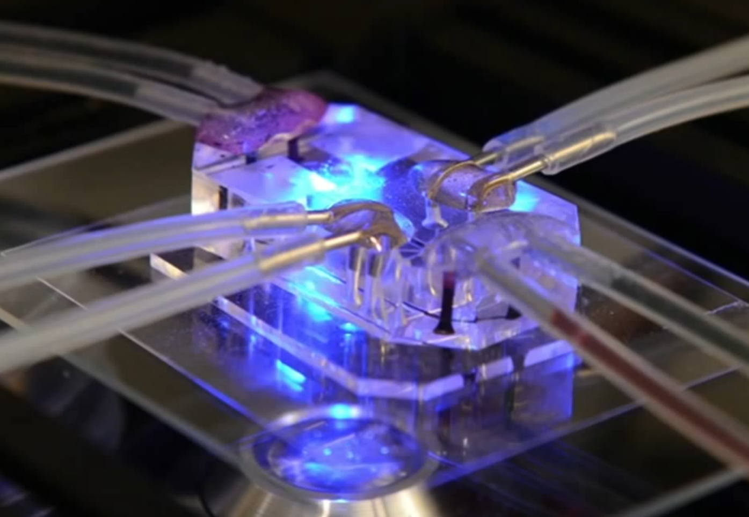
LUNG ON A CHIP
Lungs on chips to facilitate the development of new treatments. As of today, we are still unable to mimic an entire lung on a microfluidic chip.
In order to get as close as possible to a real lung It uses blood instead of a nutrient fluid, Along this microfluidic channel run two empty micro-channels, in order to reproduce the compression cycle.

Slide 10
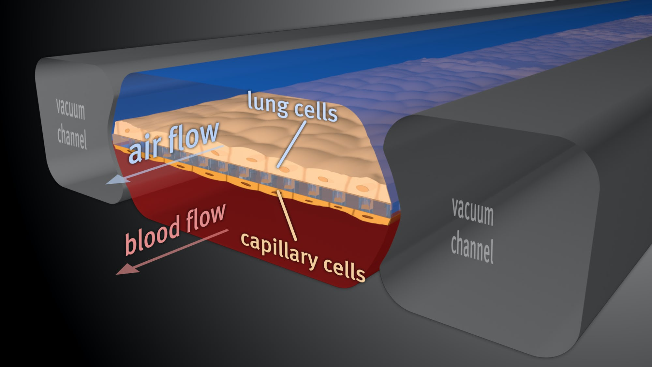
WORKING
LUNG ON A CHIP

Slide 11
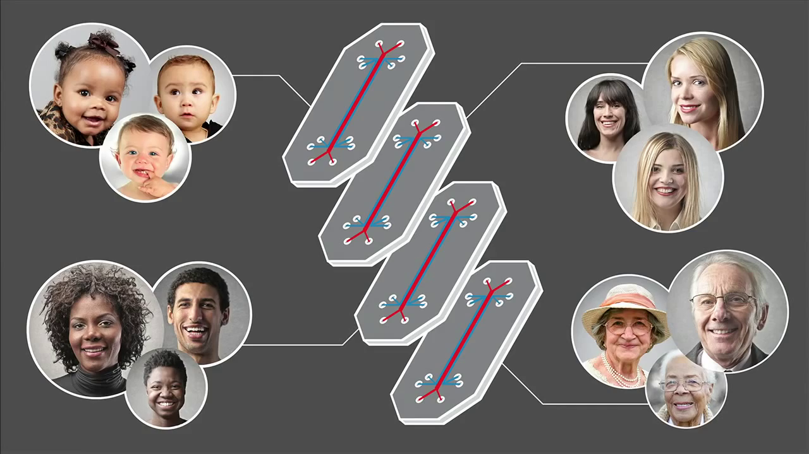

Slide 12
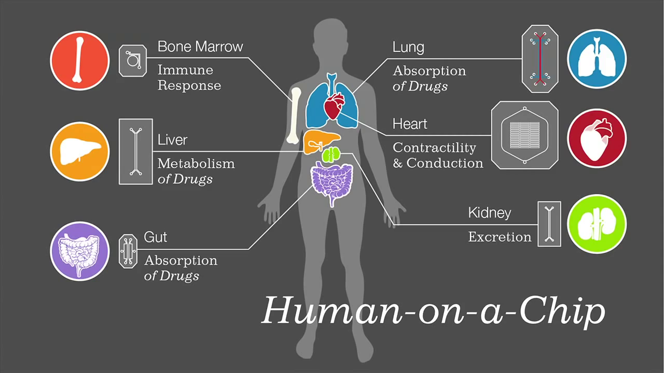
FUTURE GOALS

Slide 13

APPLICATIONS
Cosmetics – Skin on a chip
To check Drug Toxicity
Drug Analysis
To develop human tissue models
For disease modeling
Drug testing

Slide 14


THANK YOU
By
snahmed2019
mukilan_parthipan_

